Slide 1
Thesis Proposal
The Role of Emotion Regulation Strategies Between Risk Perception and Negative Emotions
Group Members: 吴旭升 杨铠宁 张哲玮 吴桐 翁静 王梦冰 王志武

Slide 2
01
Preliminary dicussion and results
02
Thesis statement
03
Contents
Methods or approach
04
Work plan with timetable
05
Implication of research
06
Limitations of research

Slide 3
PART 1
Preliminary dicussion
and results

Slide 4
The sources of articles
Title of Article | Journal Source | Quartile in Category | Impact Factor
Taking control amidst the chaos: Emotion regulation during the COVID-19 pandemic | JOURNAL OF VOCATIONAL BEHAVIOR | Q1 | 4.883
Associations of risk perception of COVID-19 with emotion and mentalhealth during the pandemic | JOURNAL OF AFFECTIVE DISORDERS | Q1 | 4.226
Anxiety associated with COVID-19 and concerns about death: Impacts onpsychological well-being | PERSONALITY AND INDIVIDUAL DIFFERENCES | Q2 | 2.733

Slide 5

Background
Individuals experience more anxiety when mortality has been emphasized and express lower psychological well-being.
Used adaption of the multidimensional mortality awareness to assess individuals' fear of death.
The more individuals worry about their own deaths, the more anxiety they feel within the covid-19 pandemic social environment.
Fear of Death

Slide 6

Background
Risk Perception
Infection-risk perception——the cognitive response by individuals and for the threat of the COVID-19 pandemic
Higher risk perception of COVID-19 was significantly associated with less positive and more negative emotions.

Slide 7

Background
Emotion Regulation
Emotion regulation is the process of initiating, maintaining, and modifying one's emotional experience and expression.
Effective regulation of emotions is crucial to reducing negative emotions and enhancing well-being both within and outside work.

Slide 8
Preliminary dicussion and results
Proactive emotion regulation strategies
Reduce negative emotions
Produce positive psychological effects
Evaluate emotions
Take time to self-check during the pandemic
Actively adopting emotion regulation strategies
Enhance well-being both within and outside work
Maintain people's psychological health and resilience

Slide 9
Preliminary dicussion and results
Risk perceptions
Drive emotions and psychological distress
Higher levels of overall negative emotion
Individual negative emotions
Interventions' efficacy
Reduce safety risk perception on mental health promotion
Reduce risk perception of infection

Slide 10

Preliminary dicussion and results
Expressive writing
People can expose and release their emotions
Reconstruct cognition
Explore the role of emotion regulation strategies between risk perception and negative emotions
Find out during expressive writing which emotional regulation strategies more efficiently

Slide 11
PART 2
Thesis statement

Slide 12
Hypothesis
Emotional regulation strategies play a moderating role between risk perception and negative emotions:
a) Individuals who use emotion regulation strategies more frequently have less negative emotions when the risk perception level is the same;
b) After intervention to improve the use of emotion regulation strategies, the individual's risk perception level is reduced, and negative emotions are reduced;
Hypothesis 1

Slide 13
Hypothesis
There are one or several specific types of emotion regulation strategies that can effectively reduce individual risk perception levels and negative emotions.
Hypothesis 2

Slide 14
PART 3
Methods or Approach

Slide 15
Methods or Approach
Emotional Regulation Strategies
Emotional Regulation Strategies
Risk
Perception
Negative Emotions
?
?
?
Study 1
Study 2

Slide 16
Study 1
Stage One
Stage Two
Stage Three
1.Collect the Emotional Regulation Frequency
2.Show Risky Pictures and Words
3.Measure Risk Perception Level (IRPS)
4.Measure Negative Emotions (PANAS)
5.Analyze Data (ANOVA)
2 Weeks Intervention
Emotion Regulation Method : Expressive Writing
Repeat Step 2,3,4 in Stage One
Analyze Negative Emotions

Slide 17
Study 2
Interview the Participants
Find Out the Strategies
Grounded Theory

Slide 18
PART 4
Work plan with timetable

Slide 19
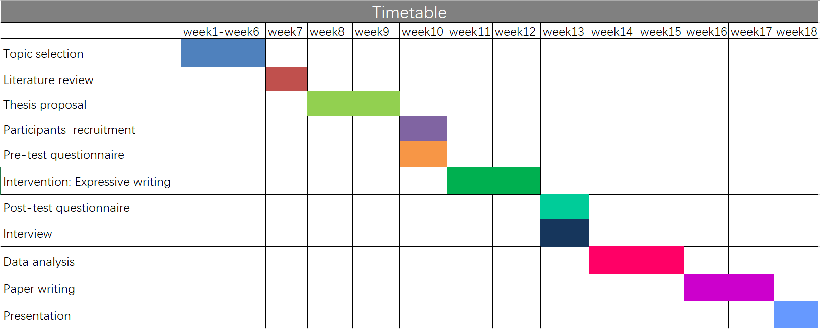
Timetable

Slide 20
PART 5
Implication of research

Slide 21
Implications
necessity
People's perception and judgment of risk will affect people's behavior to deal with risk.
innovation
no large-scale population-based studies have examined associations of risk perception of COVID-19 with emotion and subsequent mental health problems.

Slide 22
Implications
applied
Our research suggests that early detection and intervention of negative emotions could contribute to the prevention of mental health problems, and that frequent using of some emotion regulation strategies could effectively reduce negative emotions in the face of sudden events.

Slide 23
PART 6
Limitations of research

Slide 24

Limitations
The intervention effect is affected by personal life events greatly
The study was conducted in the context of life, without the strict control on irrelevant variable, unable to isolate the effects of social and individual life events. But on the other hand, if it's strictly controlled in accordance with laboratory procedures, the result will be lost the value of practical application.

Slide 25

Limitations
The gender differences were not discussed
The study about emotion regulation strategy did not consider of the differences between male and female, and the gender has or has not the impact on the efficacy of the intervention is still controversial.

Slide 26

Limitations
The relevant studies on cognitive emotion regulation strategies should be refined
In the process of cognitive emotion regulation strategy has great individual differences.
In future studies, cognitive emotion regulation strategies can be subdivided to explore more effect of risk perception and judgement.

Slide 27
THANKS!
Group Members: 吴旭升 杨铠宁 张哲玮 吴桐 翁静 王梦冰 王志武

